Slide 1

Natural Join
Infoway Technologies, 3rd Floor Commerce Centre, Rambaug Colony, Paud Road Pune 411038

Slide 2
Natural Join
The NATURAL JOIN is such a join that performs the same task as an INNER JOIN. NATURAL JOIN does not use any comparison operator. We can perform a NATURAL JOIN only if there is at least one common attribute that exists between two relations. In addition, the attributes must have the same name and domain. When this join condition gets applied always the duplicates of the common columns get eliminated from the result.
Note:
If the column-names are not same, then NATURAL JOIN will work as CROSS JOIN.
A NATURAL JOIN can be used with a LEFT OUTER join, or a RIGHT OUTER join.
Infoway Technologies, 3rd Floor Commerce Centre, Rambaug Colony, Paud Road Pune 411038

Slide 3
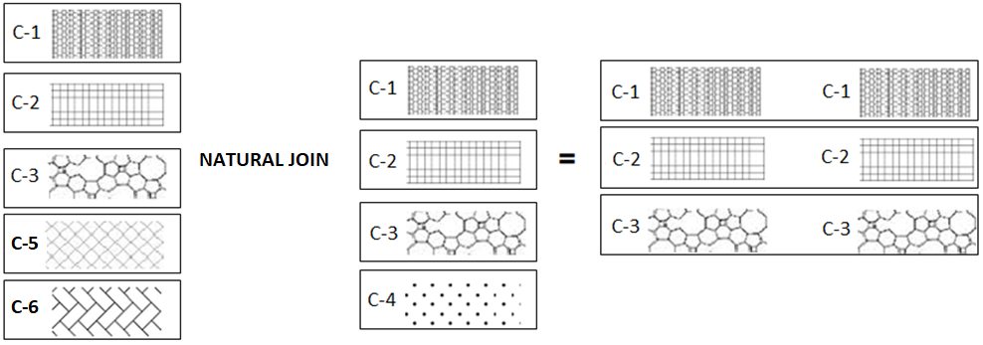
natural join
Infoway Technologies, 3rd Floor Commerce Centre, Rambaug Colony, Paud Road Pune 411038

Slide 4
natural join
The NATURAL JOIN is such a join that performs the same task as an INNER JOIN.
CREATE TABLE company (
company_id INT,
company_name VARCHAR(45),
company_city VARCHAR(45)
);
CREATE TABLE food (
item_id INT,
item_name VARCHAR(45),
item_unit VARCHAR(45),
company_id INT );
INSERT INTO company VALUES (18, 'Akas Foods', 'pune');
INSERT INTO company VALUES (15, 'Foodies', 'baroda');
INSERT INTO company VALUES (16, 'Gold Foods', 'surat');
INSERT INTO company VALUES (17, 'Natural Foons', 'pune');
INSERT INTO company VALUES (19, 'J&S Foods', 'mumbai');
INSERT INTO food VALUES (1, 'biscuit', 'packet',18);
INSERT INTO food VALUES (4, 'cakes', 'Pcs', 15);
INSERT INTO food VALUES (6, 'cheez', 'packet', 16);
INSERT INTO food VALUES (5, 'butter', 'packet', 17);
INSERT INTO food VALUES (2, 'bread', 'packet', 19);
INSERT INTO food VALUES (7, 'eggs', 'Pcs', NULL);
INSERT INTO food VALUES (3, 'salt', 'packet', NULL);
Infoway Technologies, 3rd Floor Commerce Centre, Rambaug Colony, Paud Road Pune 411038

Slide 5
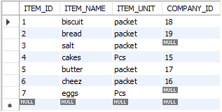
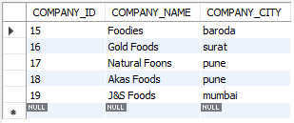
natural join
Sample table: foods
Sample table: company
Infoway Technologies, 3rd Floor Commerce Centre, Rambaug Colony, Paud Road Pune 411038

Slide 6
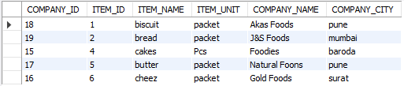
natural join
syntax
SELECT column-list FROM <table_references> NATURAL JOIN <table_references>
food = { item_id, item_name, item_unit, company_id }
company = { company_id, company_name, company_city }
SELECT * FROM food NATURAL JOIN company;
Infoway Technologies, 3rd Floor Commerce Centre, Rambaug Colony, Paud Road Pune 411038

Slide 7
Difference between Natural JOIN and INNER JOIN
NATURAL JOIN | INNER JOIN
Natural Join joins two tables based on same attribute name. | Inner Join joins two table on the basis of the column which is explicitly specified in the ON clause.
In Natural Join, The resulting table will contain all the attributes of both the tables but keep only one copy of each common column | In Inner Join, The resulting table will contain all the attribute of both the tables including duplicate columns also
In Inner Join, only those records will return which exists in both the tables | In Inner Join, only those records will return which exists in both the tables
SYNTAX: SELECT * FROM table1 NATURAL JOIN table2; | SYNTAX: SELECT * FROM table1 INNER JOIN table2 ON table1.Column_Name = table2.Column_Name;
Infoway Technologies, 3rd Floor Commerce Centre, Rambaug Colony, Paud Road Pune 411038

